Slide 1


Ice Players Assistants
Training for Wheelchair Championships

Slide 2
Ice Player Assistant (IPA) needs for on ice Duties:
Clean shoes- All IPAs must have clean shoes not worn outside. After arriving at the arena should change shoes using the shoes for duties on ice only (curling shoes or gym shoes - ok)
Dress warm and in uniform, gloves, as cleaning stones is a very physical job
Black trousers if not issued by host. No jeans allowed on ice.
If hat is worn it must match uniform and have no visible large logo.
Arrive for cleaning of Wheelchairs at ICE cleaning station 1hr 15 min prior to game time.
Arrive for your IPA duty 1 hour prior to game time. Sign in with supervisor of Volunteers. Pick up equipment: Cloth to clean stones, Delivery order card and pen.
Due to allergies of Players and Officials please refrain from the use of perfume or cologne.

Slide 3
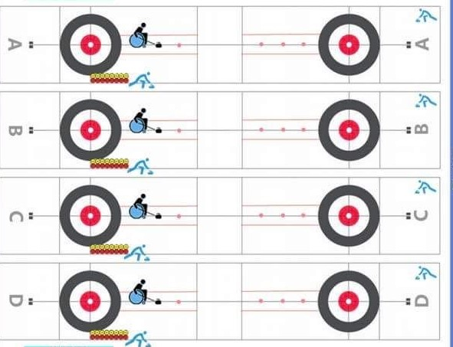
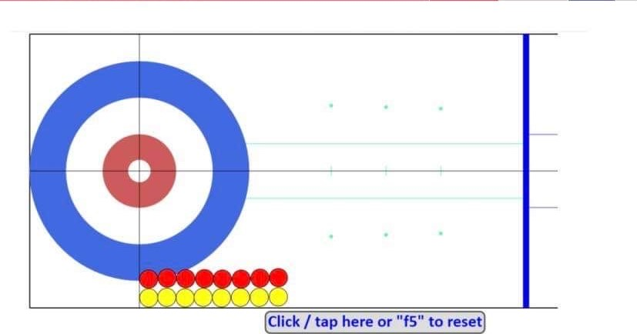
Player position for Delivery zone
Stone line up from tee line forward

Slide 4
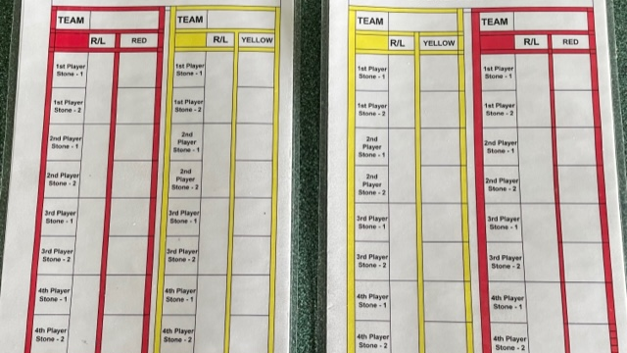
Red Team throws first stone of end
Red Team Hammer
This delivery card is two sided to show line up for stones on each end

Slide 5
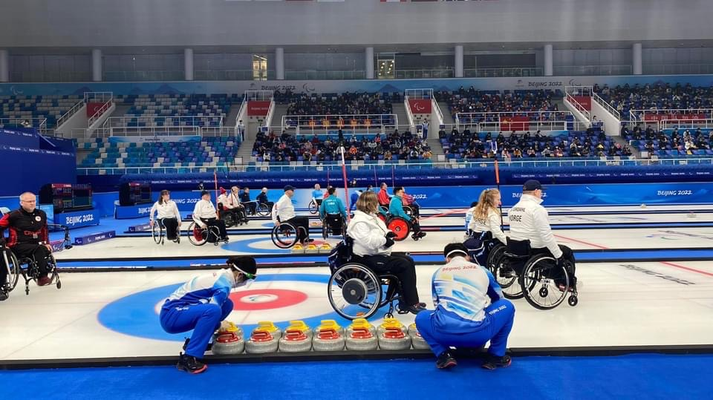
Handle positions

Slide 6
IPAs do not help clean or place stones for any team practice session. Teams run their own practice sessions.
IPA duties start in the Field of Play before each game.
There will be 2 IPAs assigned to each sheet

Slide 7
Times for Teams and IPAs to move into the Field of play:
1st Practice teams enter no sooner than 10 min prior to the scheduled time. The cue is given only when the ice tech gives the signal the ice is ready.
2nd Practice teams enter the FOP when 1st practice teams are on the ice. 2nd practice teams can be on the backboard area to watch the 1st practice team throwing stones.
IPAs enter when 2nd practice teams are on the ice for their practice. Keep to the back behind the sheet you are working. The Game Umpire for your sheet will introduce themselves and help you get the Delivery orders for your cards.
After 1st practice teams are off the ice on backboard, they will give you their Delivery order. You should move the 1st practice stones to the right corner of the ice and put them in the delivery order,
2nd practice teams will give order after their practice.
WCF placement of the stones is to be in two neat single rows, handles all turned to straight position. Teams throwing first in the end have their stones placed closest to the center line on the right side of the sheet. Team with the last stone in the end have the stones closet to the sideline. Arrange the stones so the last stones to be delivered is just touching the tee line.

Slide 8
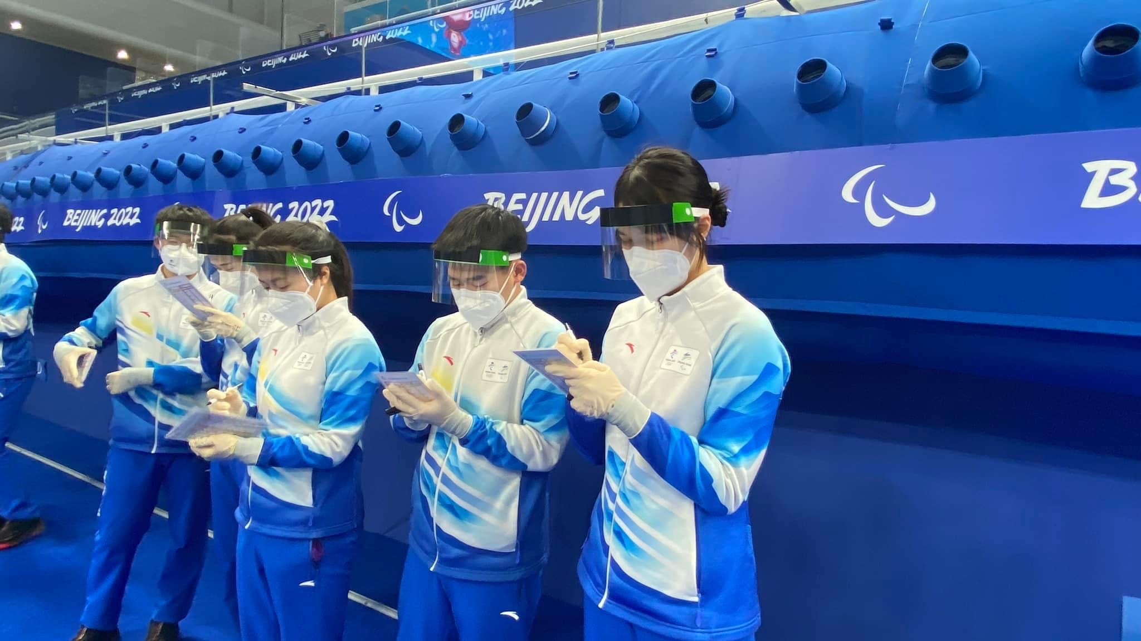
Getting Delivery cards filled out

Slide 9
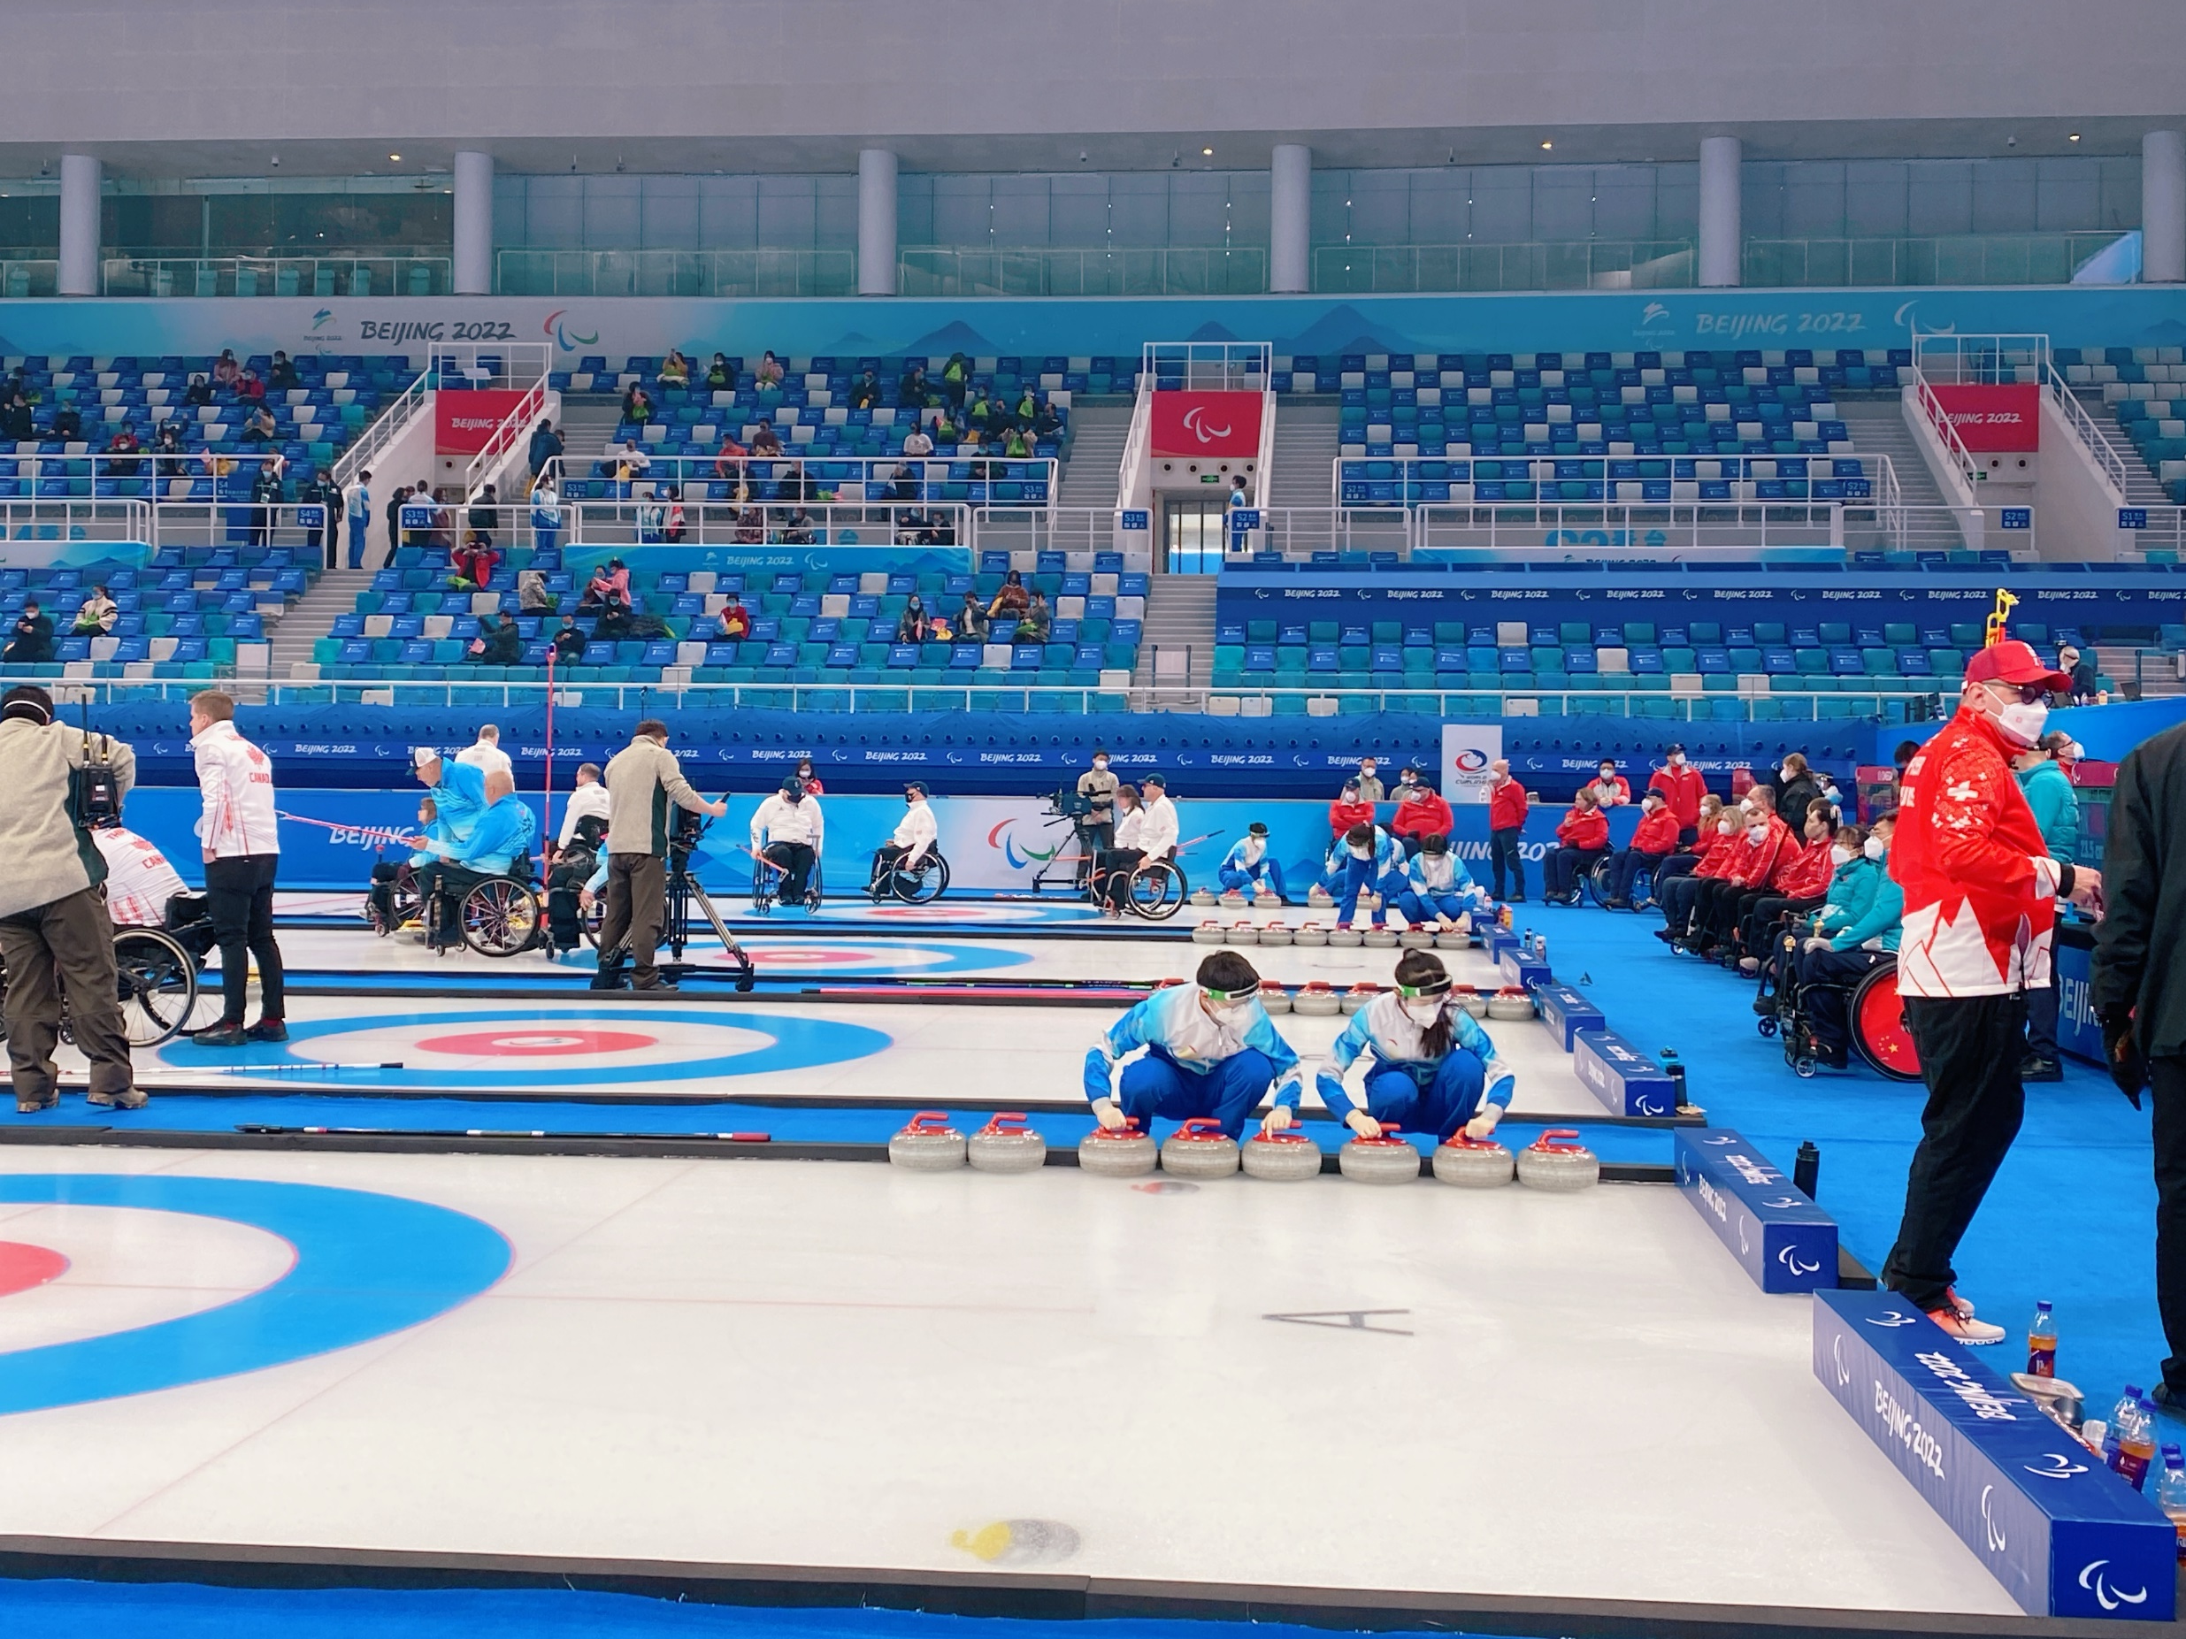
Between practice IPA place 1st practice stones to corner in delivery order

Slide 10
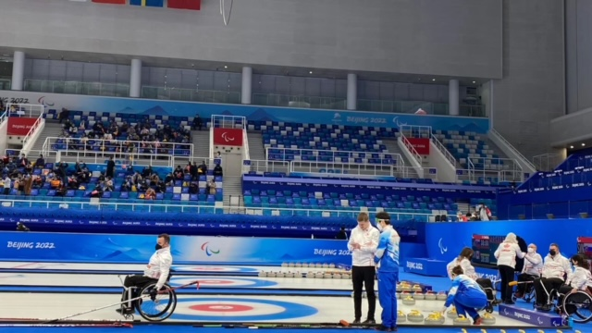
Stone order and move stones after 2nd practice

Slide 11
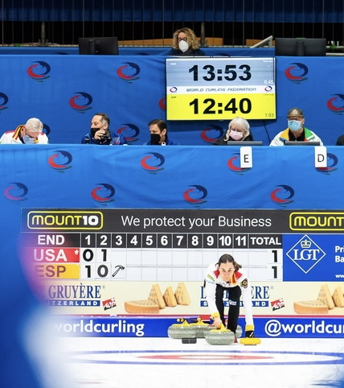
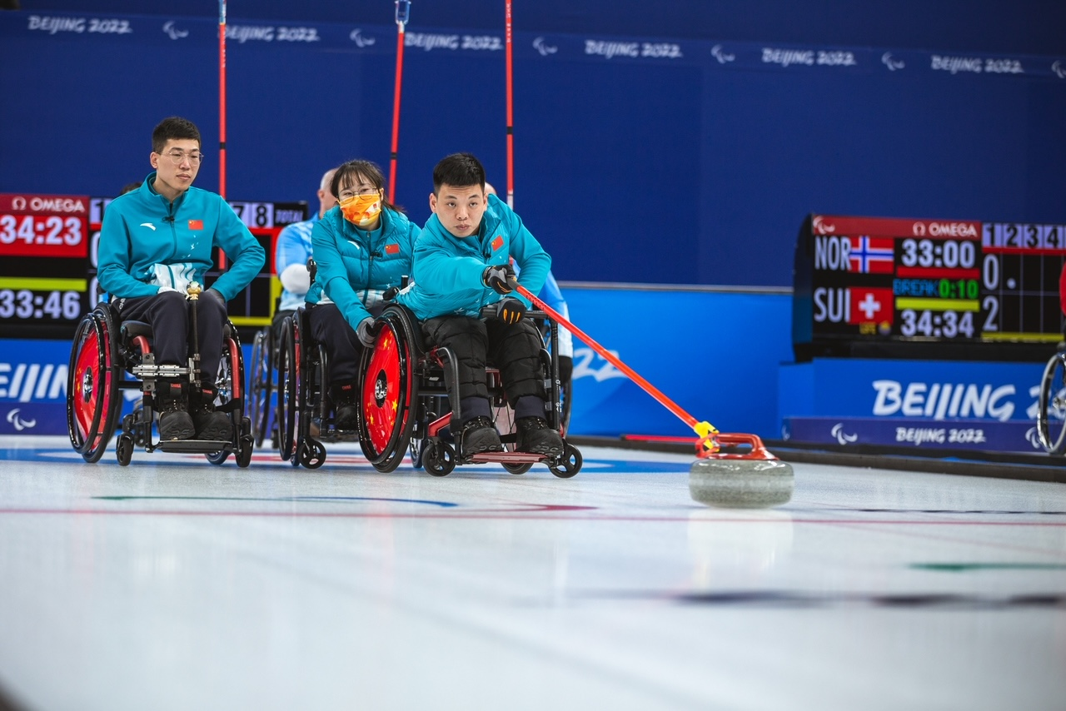
IPAs look to scoreboard for the LSD result for the fist end.
  * or hammer sign
All competition scoreboards will indicate who has the hammer and in wheelchair curling the stone order can be placed or changed by the IPA.
This scoreboard is in the 3rd end if the hammer was placed in the first end where would it be?

Slide 12
Duties of Ice Players Assistant at the Throwing end
Clean the stone at the side of the sheet (never in the delivery zone) making sure you do not bruise the ice with the striking band. Use your foot or hand to brace the stone when you turn it over (some find it easier if open part of handle is away from body and handle can then be lifted)
Clean the running edge of the stone with a micro-fibre cloth. Fold cloth into 4 and if any dirt is picked up refold the dirty side in and when you get a chance go to the trash can to shake and brush off the dirt.
After cleaning stone be sure to wipe area where the stone was turned over to clean
Sometimes the handles become sticky due to tape on delivery sticks you should wipe the handle after stone is placed in the delivery zone.

Slide 13
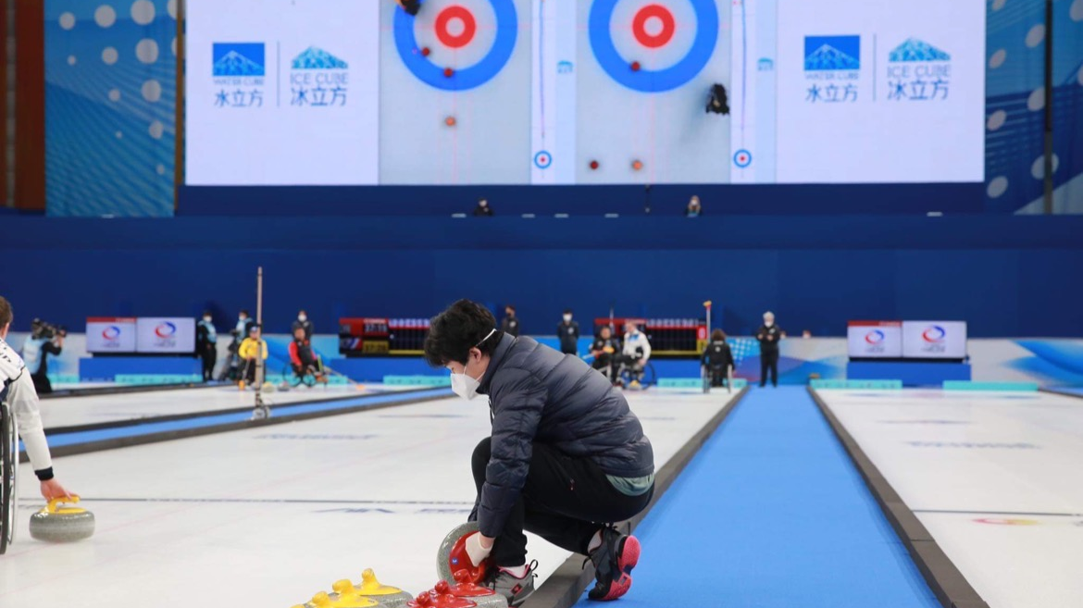

Slide 14
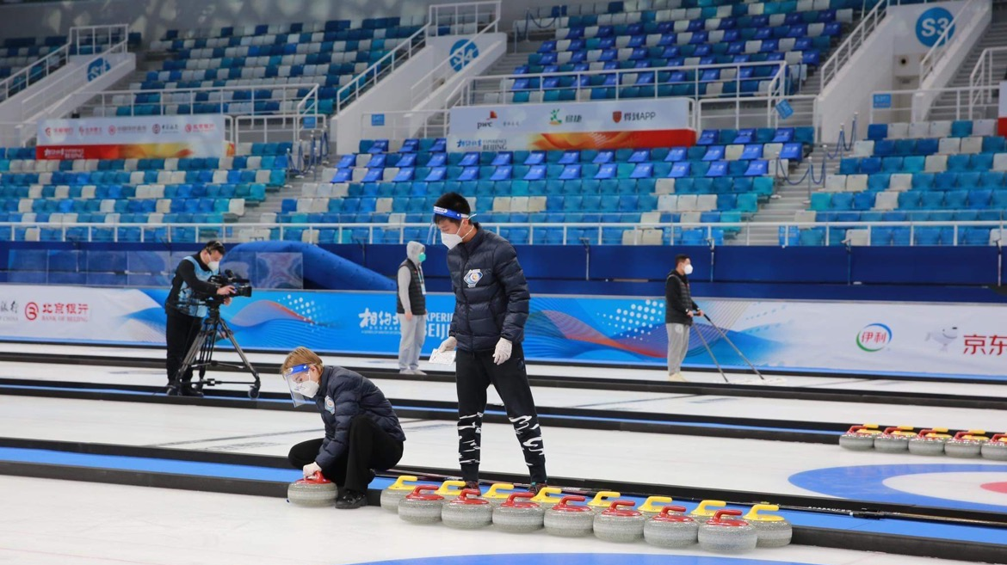

Slide 15
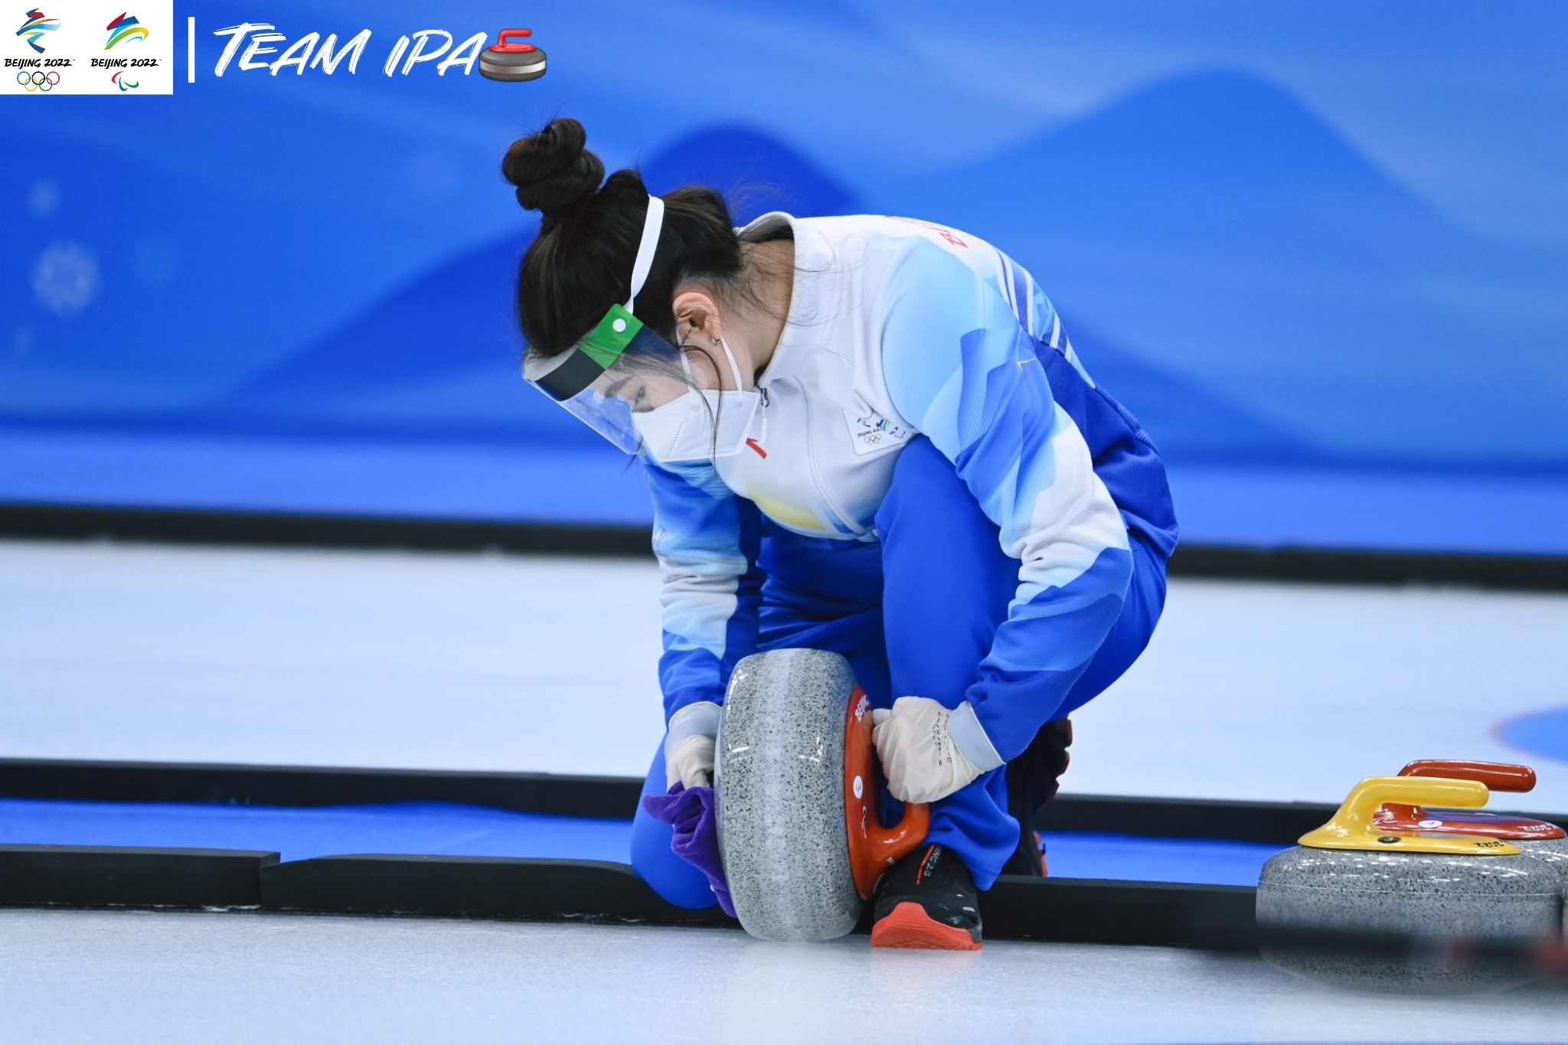

Slide 16
When placing a stone for a player, the team will indicate or tell you where they want stone.
Teams have the option to clean and place their own stones. They will clean their stone at the side of the sheet in the area you would clean, so give them some room.
Slide the stone to the area the player will deliver from and place it near the front wheel. If you feel you have picked up some debris after the stone is cleaned, take it back to the side and re-do the cleaning.
Move back to the side of the sheet and behind the thrower making sure you are quiet and still when they are getting ready to deliver.

Slide 17
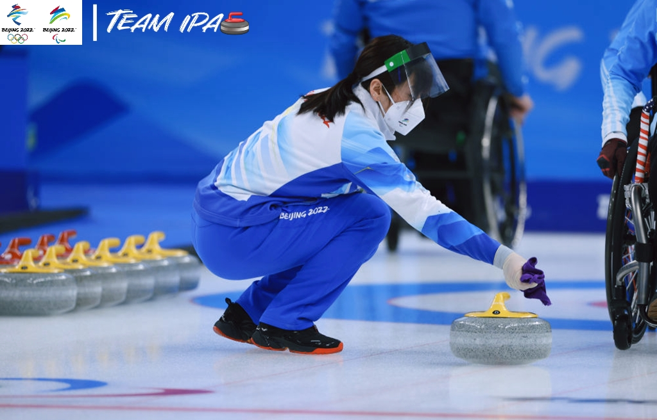

Slide 18
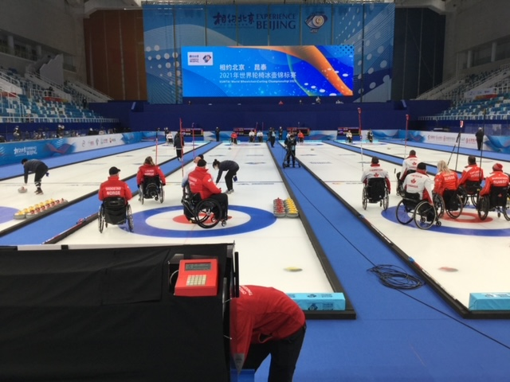
Moving stones into Delivery zone

Slide 19
Place the stones for the next player when the delivered stone is approximately 3- 5 ft over the hog line at the delivery end. Once the stone is moving down the sheet the next thrower can move into position to set up.
Delivery teams watching their stones should move forward out of the delivery zone and not restrict the set-up area for the next thrower. The IPA should move the stone into position for the next thrower to remind the thrower to exit the delivery zone.
The IPA follows the last stone of the end to the playing end after the stone is delivered. They help to sort stones and then they return to their assigned end.

Slide 20
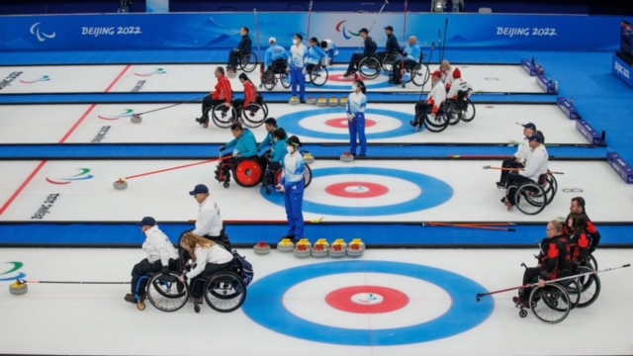
Position of Teams and IPAs during delivery

Slide 21
Turn Around between ends 60 seconds.
The break time will start when the end is completed, the score has been decided and all counting stones have been removed from the rings. At the completion of an end both IPA’s will help with moving the stones into the delivery order in preparation for the next end.
The most important job is to make sure the 1st stone of each end is ready cleaned and placed in position (30 sec left on breaktime) for the team and they are not waiting for you to clean and place the stone. The team scoring, plays the first stone in the next end.

Slide 22
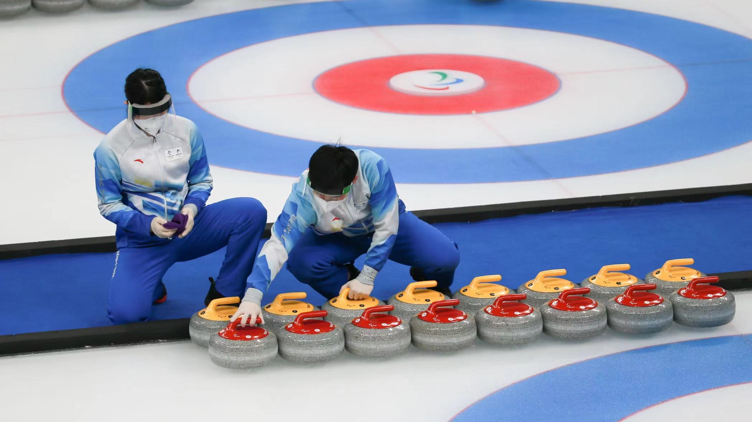

Slide 23
The most efficient way to move stones up to delivery area is to have a thrower and a catcher.
Place the hammer team against the foam and in order of delivery 1-2 -3-4-5-6-7-8 then the other color order.
When moving the stone into position set the handle to the straight handle position with a quick twist.
Last stones of the skips should be on the tee line and do not move stones up.
This will give a different path for the stones to the delivery zone and improve any track marks during the game.

Slide 24
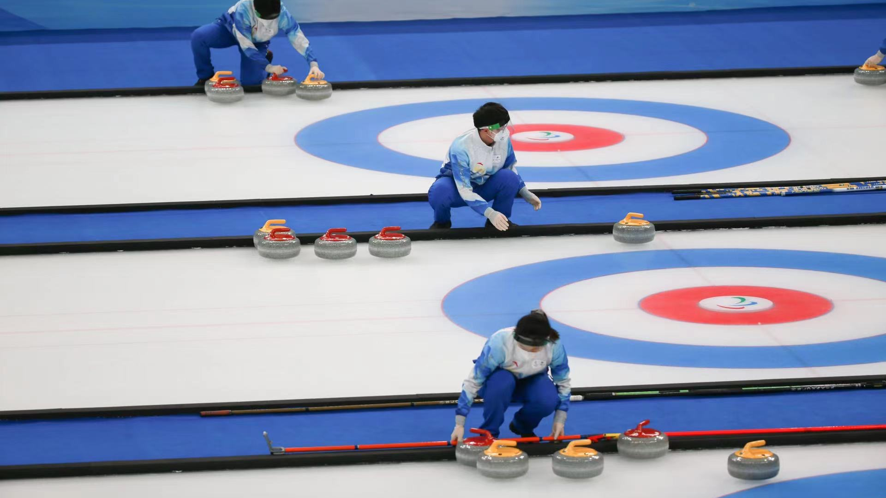

Slide 25
Sorting Stones
Use the throwing order cards to get the order correct. The cards are reversible, and it makes it easy for someone helping if the card is placed on the sideboard as soon as you know who scored. Make sure card is placed with the color of stone line up for team throwing first stone of the end.
IPAs can continue to sort stones after placing the first stone but make sure after the start of play you do not distract the throwing player by banging stones or talking
One assistant would then return to the playing end to remove stones and assist the skips at the playing end. IPAs work together to sort the stones into the delivery order at the completion of each end.
If a team delivers from in front of the house. The stones are lined up from the tee line forward with all handles pointing straight up the ice. The last stone thrown in the end is touching the tee line, with all other stones in order of delivery.

Slide 26
Before the Game
Pre-Game practice is 9 min. for each team followed by 2 players throwing a stone for the Last Stone Draw to give one of the teams’ last stone in the first end. The last stone in the first end is decided after the Last Stone Draw measures for the team having 2nd practice. Look to score board to see which team has won the LSD.
The hammer is posted on the score board after the LSD measure of the 2nd practice and the team with the hammer (last stone first end) has their stones closest to the side boards.

Slide 27
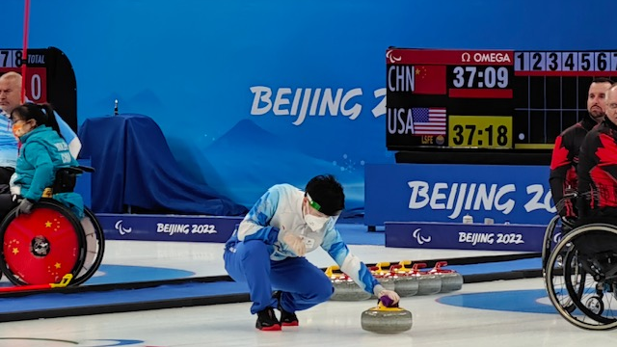
Look at the score board End 1 shows the hammer 1st end
Under USA you can see the LSD result
Paralympic clocks are different and we also use a
Display board to record the LSD measures after each practice

Slide 28
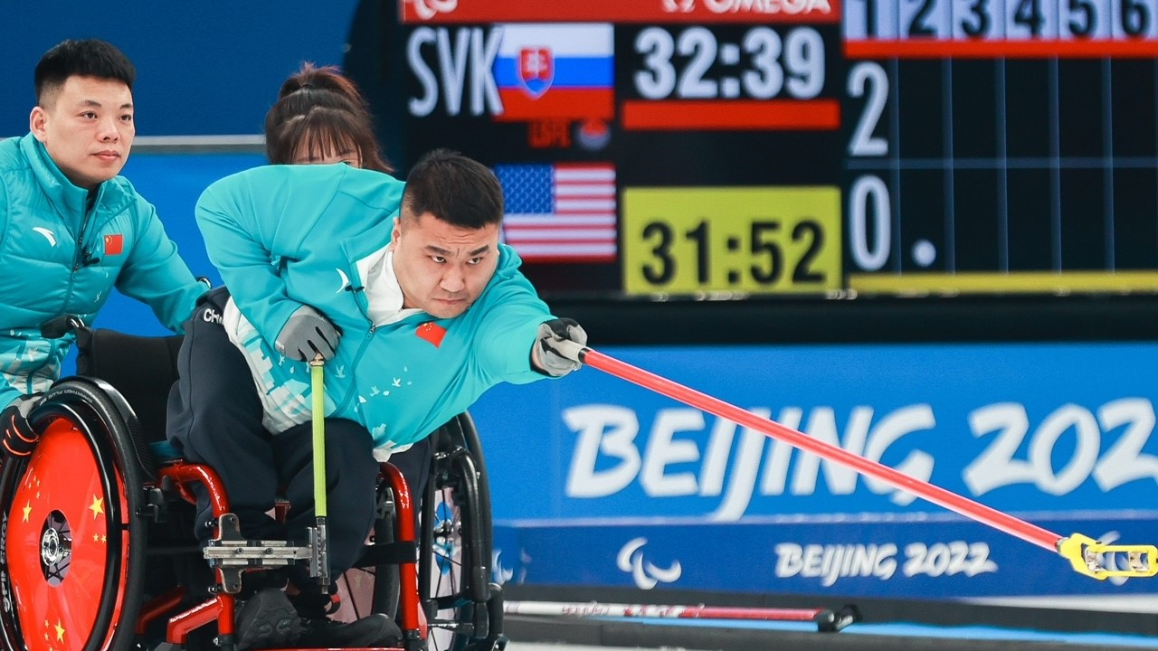
What color stones have the hammer in the 2nd end? Whatc color of stone throws first in end 2 ?

Slide 29
Getting ready for the Start of the game.
After the second practice ice mopped, light laser show begins (Paralympics) followed by introductions of teams playing on each sheet. Have all stones ready and lined up in order in the corner.
LSD winner has the last stone in the first end. Sometimes you will need to change the line up of the stone handle colors, depending on which colour is throwing the first.
Paralympics and Sports Production show. All Game umpires and IPA will exit FOP during team introductions. Exit at A gate. As soon as introductions end go straight to your sheet to get the stones moved to delivery position line up for the start of the game.

Slide 30
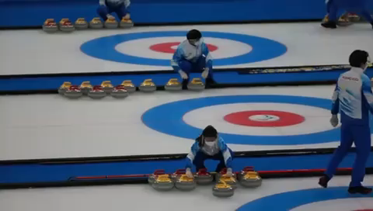
Video

Slide 31
Duties of the Ice Player Assistant- at the playing end (House).
Stand to the side of the sheet (out of the delivering players sight line, and scoreboard.) near the corner where the out-of-play stones will be sorted. Be aware of the player ready to deliver and remain still and quiet.
If asked to comment on any situation play/position of stones, make it clear it is not your role and direct them to GU.
Catch any stones that cross the backline and assist with removal of stones out of play (not clearing the hog-line, out of play at sideline) when asked by the delivering team or Game Umpire. Organize stones on right corner- in two neat parallel lines with handles pointing straight up the ice.
If a takeout shot is being played move forward in anticipation of a stone going to an adjacent sheet or rebounding back into play
If you see anything that players “miss” (eg stone touches a wheel) it is not your duty to bring to their attention, but you can mention it to the GU.

Slide 32
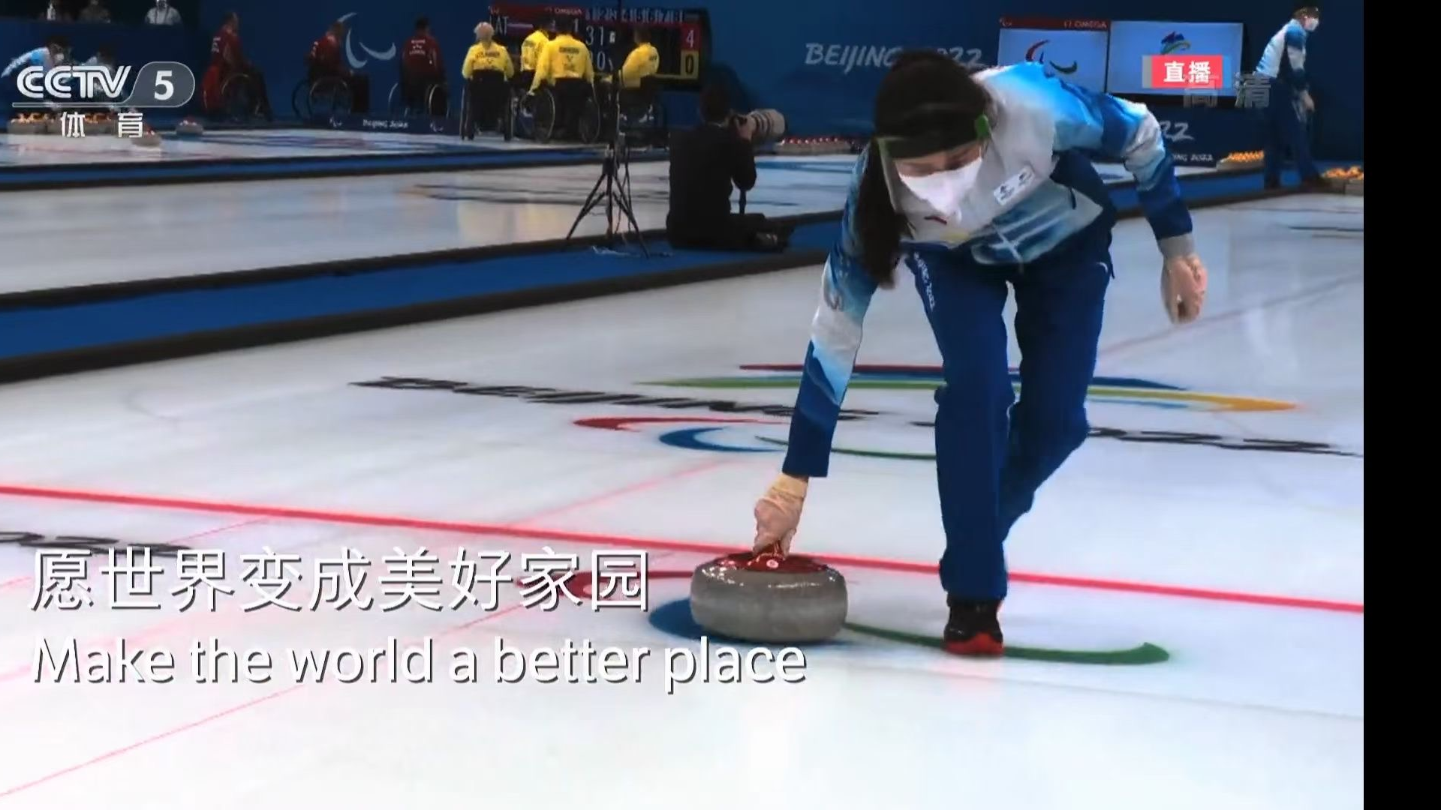
Remove stone not over the Hog Line

Slide 33
Remove stones out of play
Line up stones in delivery order so stones can be placed forward in order when end is over. You can assume team with last stone will score, but it might change.
Place the color of the stones with the hammer in the next end close to the boards. When the score is decided and the go ahead is given to clear the stones, the stones can then be moved into the delivery zone.
The team that scores will throw the first stone in the next end.
How do you know who scores? The colour of the stone closest to the center pin.

Slide 34
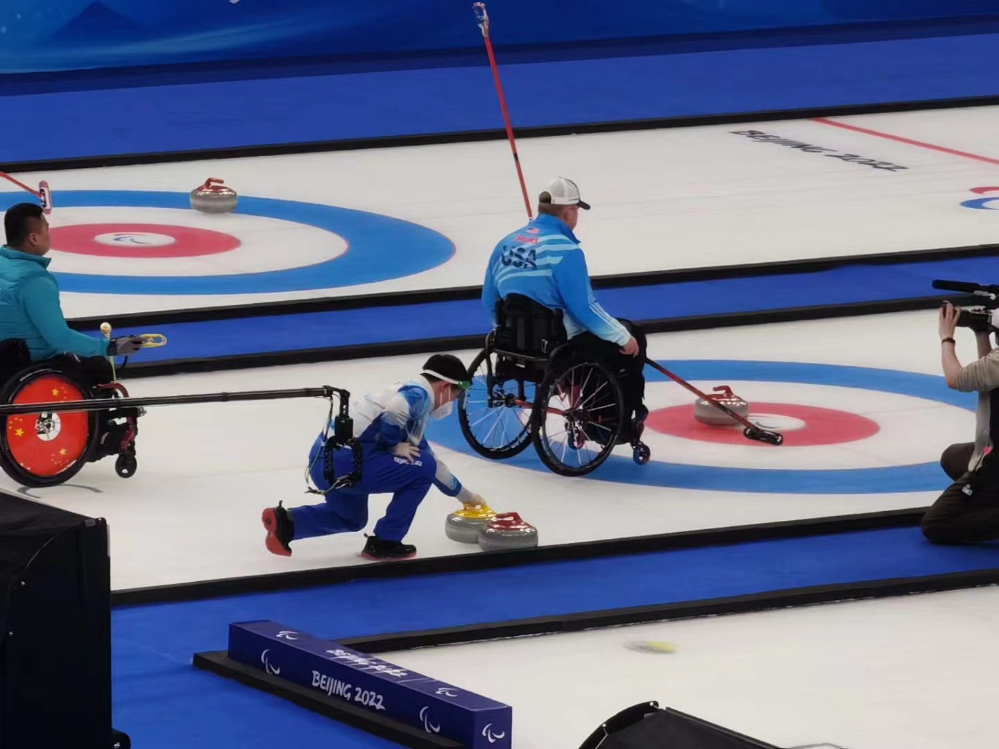

Slide 35
Clearing Stones when end completed
Do not move any stones in the house until GU gives the ok to you to clear stones.
The IPA’s can assist the teams when given the cue to help clear the stones from the GU. The stones are placed by the IPAs into the throwing order for each team.
When clearing of the stones from the house they should be moved to the side just in front of the T line.
If teams leave the house area after the end is completed without giving the score to the GU, do not move any stones from the house in case of a measure.

Slide 36
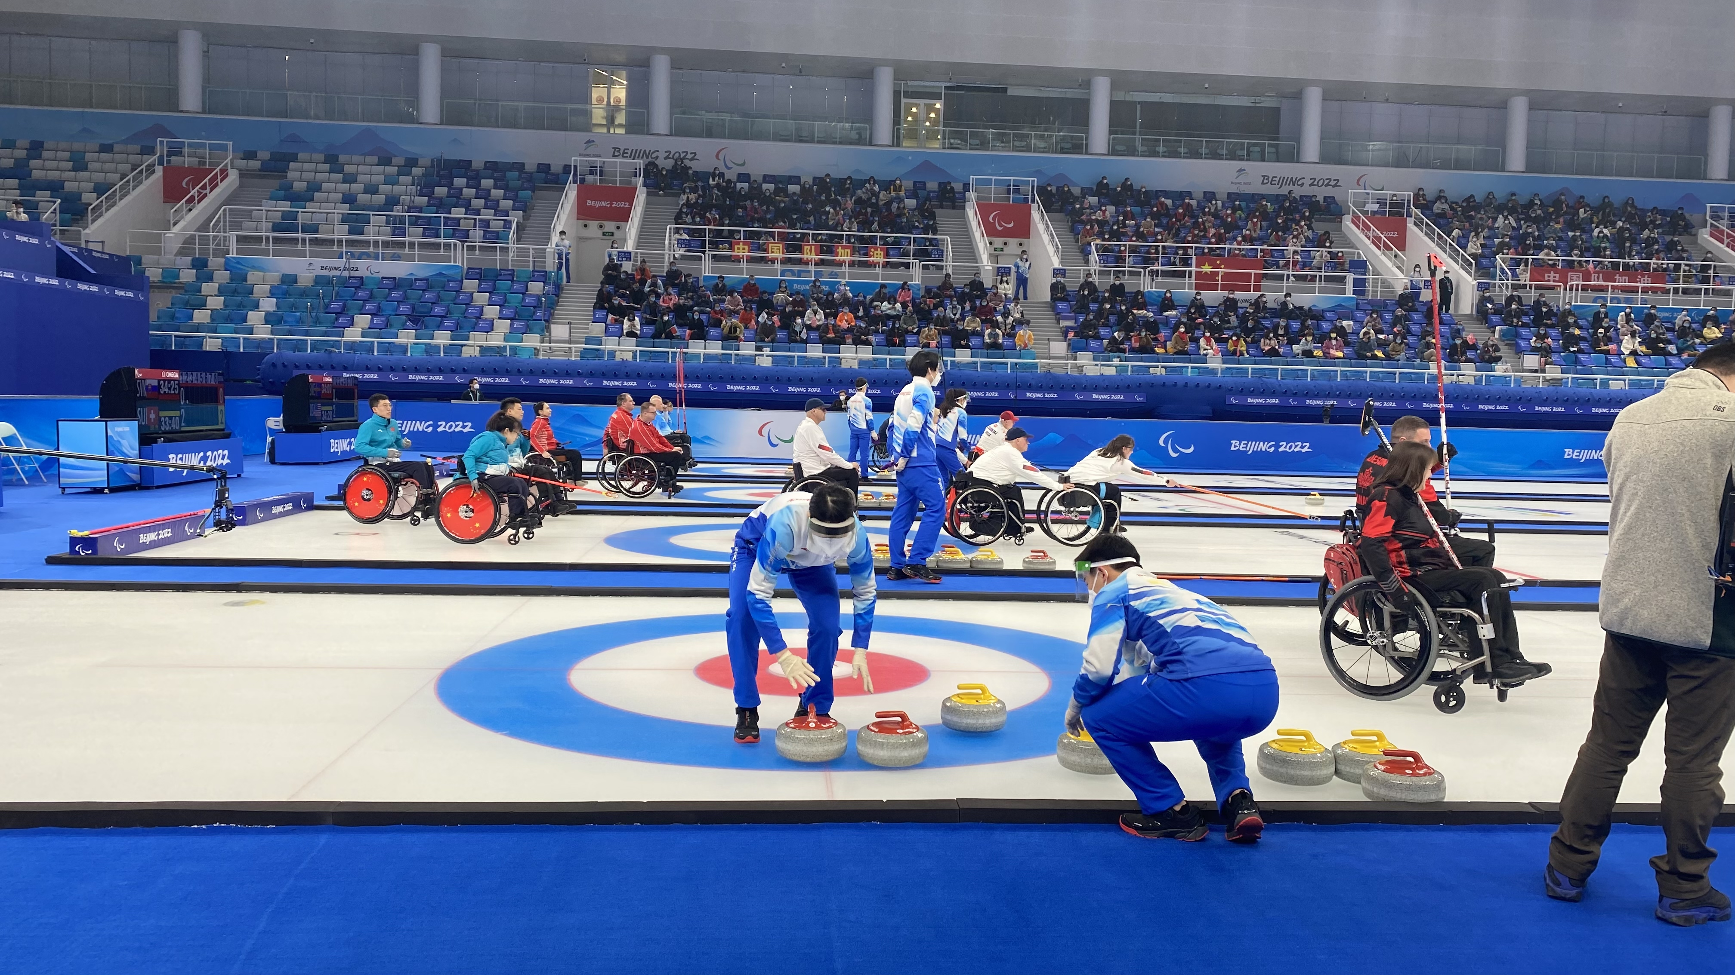

Slide 37
IF A MEASURE HAS BEEN CALLED FOR, step back and wait for direction from the game umpire.
move to the corner stone collecting area and do NOT move stones in the house.

Slide 38
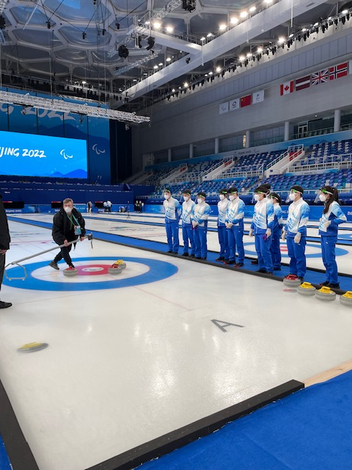

Slide 39
Thinking Time: for your information
8 End games Game time 38 minutes (per team) Extra end is 6 minutes (per team)
Time outs
Each team has one- 60 second Time out during the game and one additional time out in an extra end. This call is made from the teams to the game umpires. IPAs can get the attention of the game umpire if a team is asking for a Time out with a hand signal "T".
When a time out is called move the stone in the delivery zone to the side of the sheet and place the stone into delivery position when 30 seconds is left on the clock or before if the team is getting set up to return to play.

Slide 40
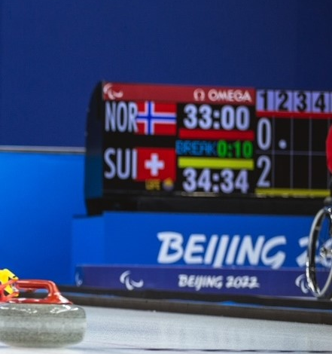
Time runs on clock for break between ends
Travel time for coach and Timeout
after the break the clock will not start if the team throws their stone with in 10 seconds. It shows on the clock.
IPA watch the break to know when to place the stone into the delivery position.

Slide 41
4th end break – 5 min
Stones should not be moved forward until the ice is cleaned during the mid game break.
Teams will meet with their coach and a break will allow you to have a break too.
IPA will have an opportunity for a short break after the 4th end but must watch the countdown clock so they will be in position when the team is ready to throw. (they can use a stopwatch to keep track of the break time remaining)
IPAs must have the first stone in the delivery position 30 seconds prior to the end of the 5 minute break.

Slide 42
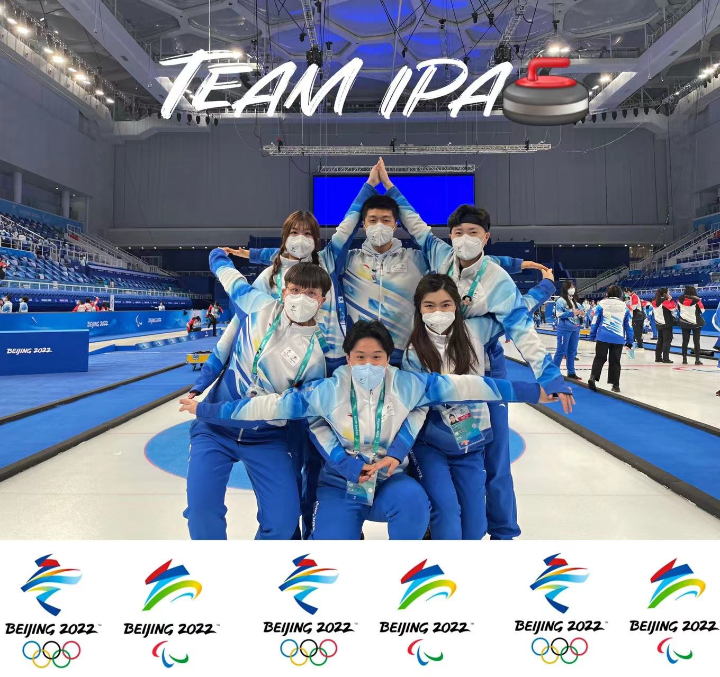

Slide 43
Wheelchair Cleaning station
The IPA are often asked to assist with the wheelchair cleaning.
It is important to keep all debris off the ice and this is an important part of the Wheelchair game.

Slide 44
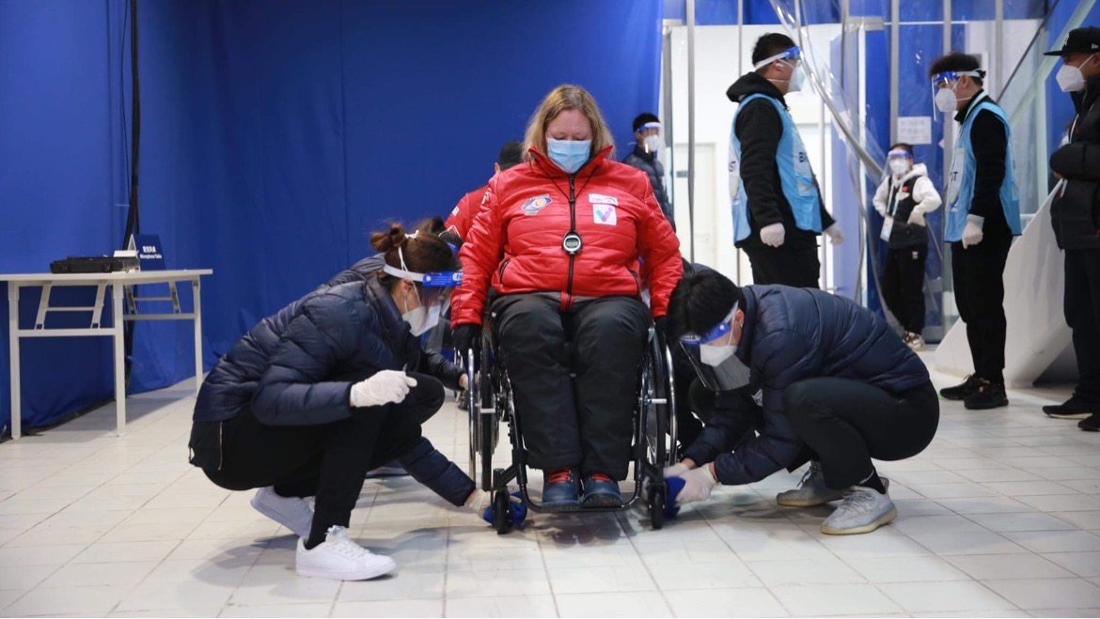

Slide 45


Slide 46
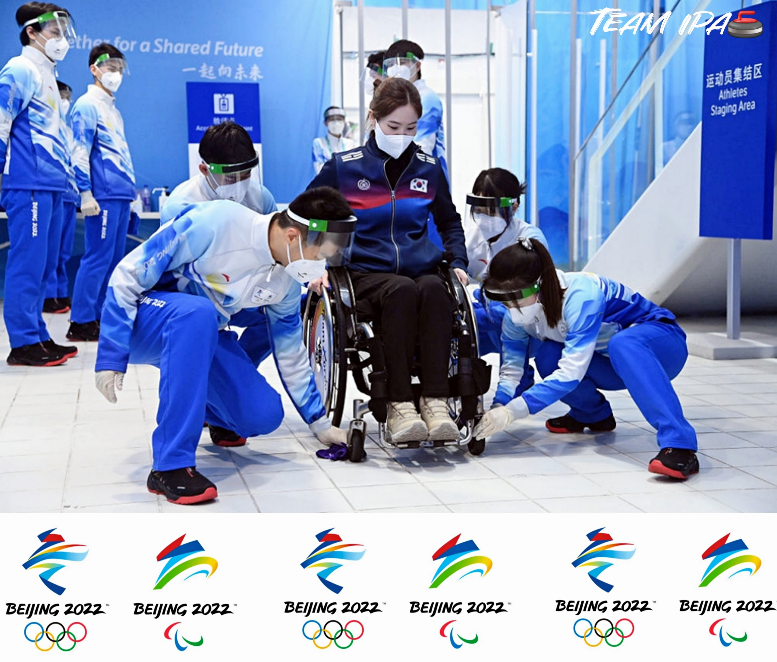

Slide 47
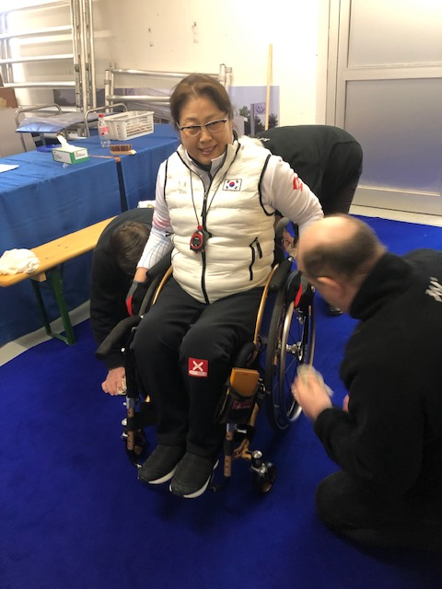

Slide 48
Questions ?
Thank you for volunteering for this important position. Our wheelchair athletes could not play at this competitive level without your assistance!
VIDEO LINK
https://www.facebook.com/FR521/videos/663347024896384/?d=n

